Slide 1
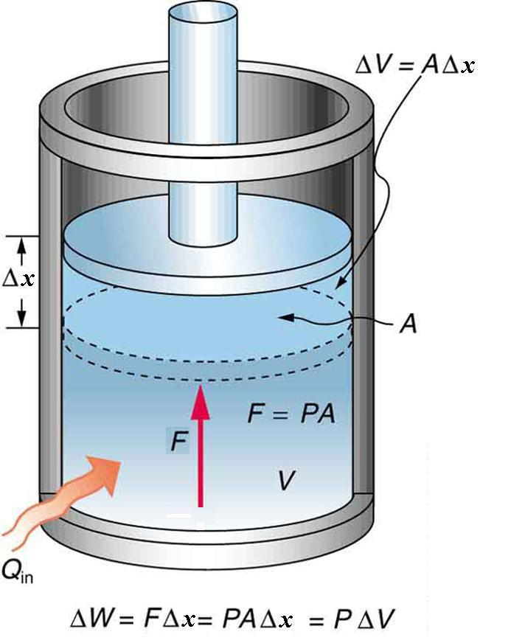
Lecture #6
Laws of Thermodynamics

Slide 2
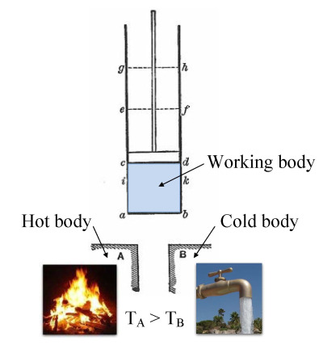
Thermodynamics
Thermodynamics is the branch of physics that deals with heat and temperature, and their relation to energy, work, radiation, and properties of matter. 

Slide 3
Thermodynamics
Thermodynamical system 
Thermodynamical equilibrium 
Thermodynamical parameters 
Internal energy of the system 

Slide 4
Thermodynamical system
- the set of macroscopic bodies which have interaction and energy exchange with each others, and with surrounding.

Slide 5
Types of Thermodynamic Systems
There are three mains types of system: open system, closed system and isolated system.
1) Open system: The system in which the transfer of mass as well as energy can take place across its boundary is called as an open system.
2) Closed system: The system in which the transfer of energy takes place across its boundary with the surrounding, but no transfer of mass takes place is called as closed system. The closed system is fixed mass system. The fluid like air or gas being compressed in the piston and cylinder arrangement is an example of the closed system. In this case the mass of the gas remains constant but it can get heated or cooled.
3) Isolated system: The system in which neither the transfer of mass nor that of energy takes place across its boundary with the surroundings is called as isolated system. For example if the piston and cylinder arrangement in which the fluid like air or gas is being compressed or expanded is insulated it becomes isolated system. Here there will neither transfer of mass nor that of energy.

Slide 6
Thermodynamical parameters
Set of physical quantities which characterize the properties of thermodynamical system.
Usually P,V, T are considered as systems parameters.

Slide 7
Thermodynamical equilibrium
Two systems, each in thermal equilibrium with a third system, are in thermal equilibrium with each other. This rule is known as the zeroth law of thermodynamics.
- When conditions of macroscopic system is not changing by time.
Equilibrium thermodynamics is the study of transfers of matter and energy in systems or bodies that, by agencies in their surroundings, can be driven from one state of thermodynamic equilibrium to another. The term 'thermodynamic equilibrium' indicates a state of balance, in which all macroscopic flows are zero; in the case of the simplest systems or bodies, their intensive properties are homogeneous, and their pressures are perpendicular to their boundaries.

Slide 8
Thermodynamics
A thermodynamic system interacts with its environment by heat transfer and or work. In this case the system’s internal energy may change. By internal energy we mean the total kinetic and potential energy. Be sure you understand the differences among temperature, internal energy, and heat. Temperature is a measure of the warmth of an object;
Heat is the transfer of energy to or from an object, either by changing the kinetic energy of the atoms. `
Internal Energy
The internal energy of a system is identified with the random, disordered motion of molecules; the total (internal) energy in a system includes potential and kinetic energy.

Slide 9
Two methods how to change
the internal energy
By heat transfer
By doing the work

Slide 10
The First Law of Thermodynamics
The first law of thermodynamics states that the change in internal energy of a system equals the net heat transfer into the system minus the net work done by the system. In equation form, the first law of thermodynamics is
Q=W+ΔU
Where ΔU is the change in the system’s internal energy.
ΔU=Q-W
Here ΔU is the change in internal energy U of the system. Q is the net heat transferred into the system—that is, Q is the sum of all heat transfer into and out of the system. W is the net work done by the system—that is, W is the sum of all work done on or by the system. We use the following sign conventions:
if Q is positive, then there is a net heat transfer into the system; if W is positive, then there is net work done by the system. So positive Q adds energy to the system and positive W takes energy from the system.

Slide 11
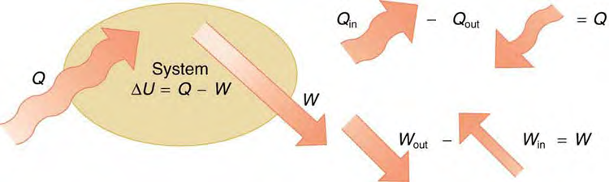
The First Law of Thermodynamics
Internal energy—the sum of the kinetic and potential energies of a system’s atoms and molecules. Can be divided into many subcategories, such as thermal and chemical energy. Depends only on the state of a system (such as its P , V , and T ), not on how the energy entered the system. Change in internal energy is path independent.
Q Heat—energy transferred because of a temperature difference. Characterized by random molecular motion. Highly dependent on path. Q entering a system is positive.
W Work—energy transferred by a force moving through a distance. An organized, orderly process. Path dependent. W done by a system (either against an external force or to increase the volume of the system) is positive.

Slide 12
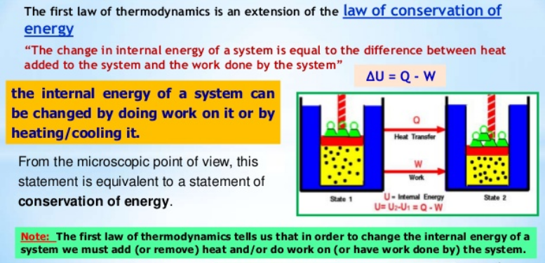

Slide 13
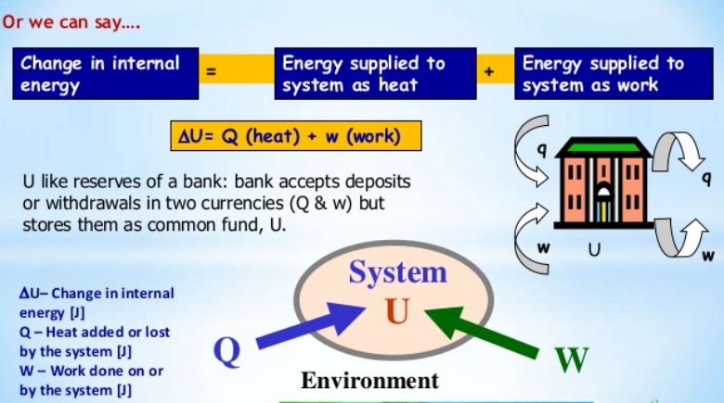

Slide 14
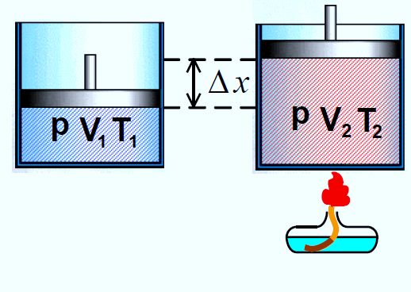
The first law of thermodynamics
The change in internal energy is independent of the process path.
2) Work in thermodynamics

Slide 15
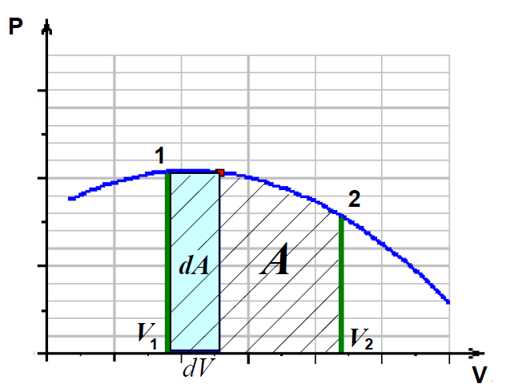
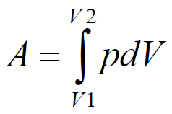

Slide 16
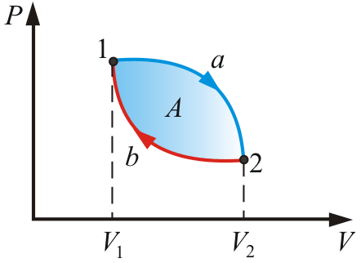
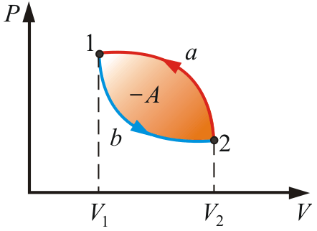
For positive work
For negative work

Slide 17
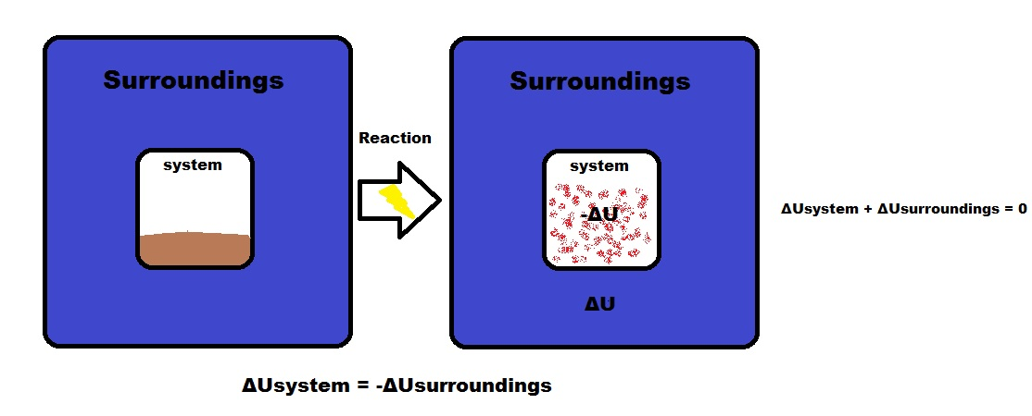
Energy is Conserved
ΔU_{system} = -ΔU_{surroundings}
The signs of internal energy
Energy entering the system is POSITIVE (+), meaning heat is absorbed, Q>0. Work is thus done on the system, W>0
Energy leaving the system is NEGATIVE (-), meaning heat is given off by the system, Q<0 and work is done by the system, W<0
ΔU_{isolated system} = 0,
ΔU_{system} = -Δu_{surroundings} energy is conserved.

Slide 18
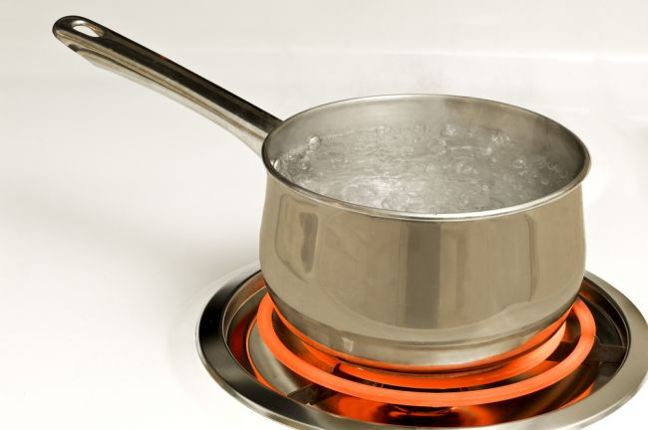
3) Quantity of heat
Types of heat transfer:
heat conductivity
convection
radiation
Heat is energy can be converted from one form to another, or transferred from one object to another. For example, a stove burner converts electrical energy to heat and conducts that energy through the pot to the water. This increases the kinetic energy of the water molecules, causing them to move faster and faster.

Slide 19
Conduction | Convection | Radiation
Relatively slow process | A more rapid process | A still more rapid
Heat energy is transferred without any net movement of the material itself. | Is accomplished through the mass motion or flow of some fluid | Realize by electromagnetic radiation (as a light radiation)
Environment is necessary. Not occur in a vacuum. | Environment is necessary. Not occur in solids and vacuum. | This process requires neither contact nor mass flow, nor any environment, and can pass through empty space (a vacuum).

Slide 20
Heat capacity-Calorimetry
Heat capacity is a quantity of heat energy required to raise the temperature of a substance by 1 К
Specific heat capacity is a quantity of heat energy required to raise the temperature of 1 kg of a substance by 1 К.
Molar heat capacity is heat capacity of 1 mole of substance

Slide 21
The heat input to the system is going to the change of systems internal energy and to the work done by the system.
Q = A + ΔU
For the cycles dU=0, then dA=dQ.
It is impossible to design a perpetual motion machine which works without energy income.

Slide 22
Application of the first law of thermodynamics to isoprocesses.
A process in which the volume of the system does not change is called isovolumetric or isochoric. In a process that goes forward at constant volume, no displacement can take place, so the work done by the system is zero. Then, from the first law, we have only two terms,
Q=ΔU
Isometric process
V=const; dA=PdV=0
When dQ=dU
all the heat income to the system goes to the energy change

Slide 23
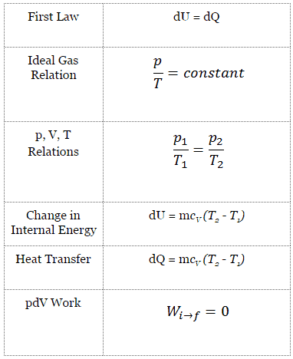
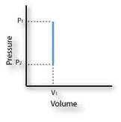

Slide 24
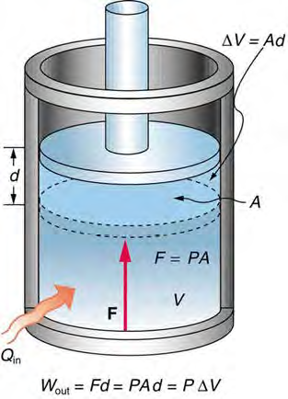
Isobaric process
If the pressure does not change during a process, the is called isobaric. One example, an isobaric process is the boiling of water in an open container. Since the container is open, the process occurs at constant atmospheric pressure. At the boiling point, the temperature of the water no longer increases with the addition of heat.
In figure shows a cylinder of gas fitted with a piston. If the gas pushes the piston out an amount Δd, the work done FΔd can be written in terms of the pressure P and the change in volume ΔV:
ΔW=FΔd=PAd=PΔV

Slide 25
Isobaric process
An isobaric process is a thermodynamic process, in which the pressure of the system remains constant (p = const). The heat transfer into or out of the system does work, but also changes the internal energy of the system.

Slide 26
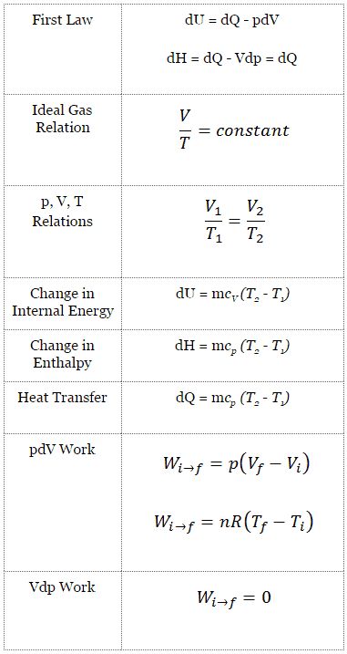
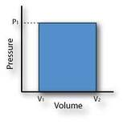

Slide 27
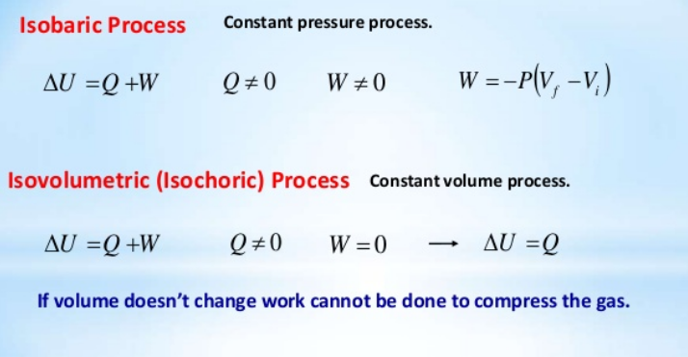

Slide 28
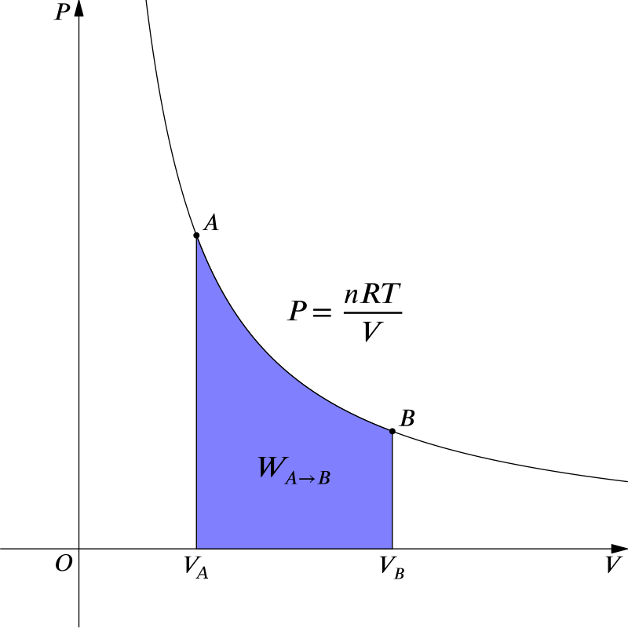
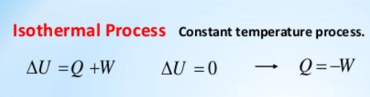
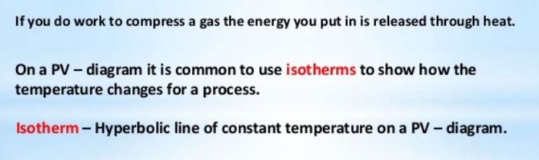
Application of the first law of thermodynamics to Isothermal process (T=const),
If the temperature of a system does not change during a process, the process is said to be isothermal. Therefore, from the first law, the heat observed by the system must equal the work done by the system:
Δ U = 0 Q=W

Slide 29
Isothermal process
Т =const; then dT=0. When dU=0 and dQ=PdV
Heat is transforming to the work

Slide 30
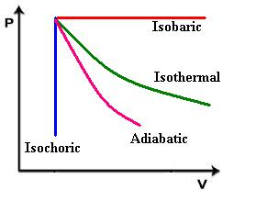
The First Law of Thermodynamics
A state variable. A state variable is a physical property that characterizes the state of a system independently of how that particular state is reached.
For example, a cup of tea that is at room temperature has the same temperature whether it cools from boiling temperature or is heated from freezing temperature; temperature is a state variable.
Under some conditions, two state coordinates completely specify the thermodynamic state of a system.
Then we can represent any possible state by a point on a two-dimensional plot

Slide 31
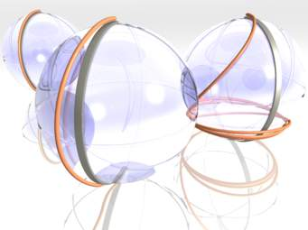
Adiabatic process
No heat enters or leaves the system during process, then the system is perfectly isolated from its environment.
A good approximation to an adiabatic process is anything that happens so rapidly that heat does not have time to flow in or out of the system, as in the rapid compression of air in a tire pump.
First Law of Thermodynamics for adiabatic process:
Q = 0 dU = - W
change in internal energy is the negative if the positive work done by the system.

Slide 32
Equation of Adiabatic process
An adiabatic process is one in which no energy is transferred by heat between a system and its surroundings.
For example, if a gas is compressed (or expanded) rapidly, very little energy is transferred out of (or into) the system by heat, so the process is nearly adiabatic. Another example of an adiabatic process is the slow expansion of a gas that is thermally insulated from its surroundings.
All three variables in the ideal gas law (P, V, and T ) change during an adiabatic process.
First Law of Thermodynamics for adiabatic process:
Q = 0 dU = - W

Slide 33
Let’s imagine an adiabatic gas process involving an infinitesimal change in volume dV and an accompanying infinitesimal change in temperature dT. The work done by the gas is W = P dV.
Because the internal energy of an ideal gas depends only on temperature, the change in the internal energy in an adiabatic process is the same as that for an isovolumetric process between the same temperatures, dU = nC_{V} dT
dU = - W
nC_{V} dT = -PdV

Slide 34


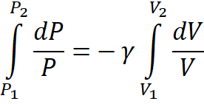

Taking the total differential of the equation of state of an ideal gas, PV = nRT, gives
P dV + V dP = nR dT
Eliminating dT from these Equations, we find that
P dV + V dP =-RPdV/C_{V}
Substituting R = C_{P} - C_{V} and dividing by PV gives

Slide 35

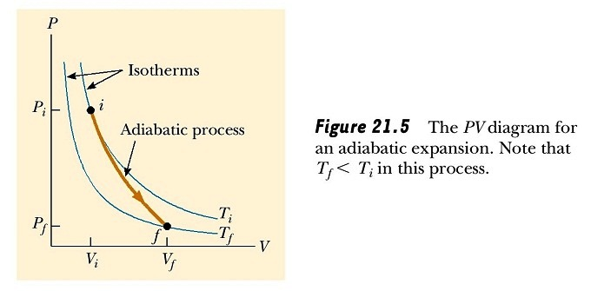
ln P₂/P₁ = - ln (V₂/V₁)^{γ}
which is equivalent to
or P₁ ∙V₁^{γ} = P₂∙V₂^{γ} =Constant
Because γ > 1, the PV curve is steeper than it would be for an isothermal expansion, for which PV = constant.
The PV diagram for an adiabatic expansion

Slide 36
By the definition of an adiabatic process, no energy is transferred by heat into or out of the system. Hence, from the first law, we see that ΔU is negative (work is done by the gas, so its internal energy decreases) and so ΔT also is negative. Therefore, the temperature of the gas decreases (T₂ < T₁) during an adiabatic expansion. Conversely, the temperature increases if the gas is compressed adiabatically.
Using the ideal gas law, we can express Equation of adiabatic process as
T₁ ∙V₁^{(γ-1)} = T₂∙V₂^{(γ-1)} =Constant

Slide 37
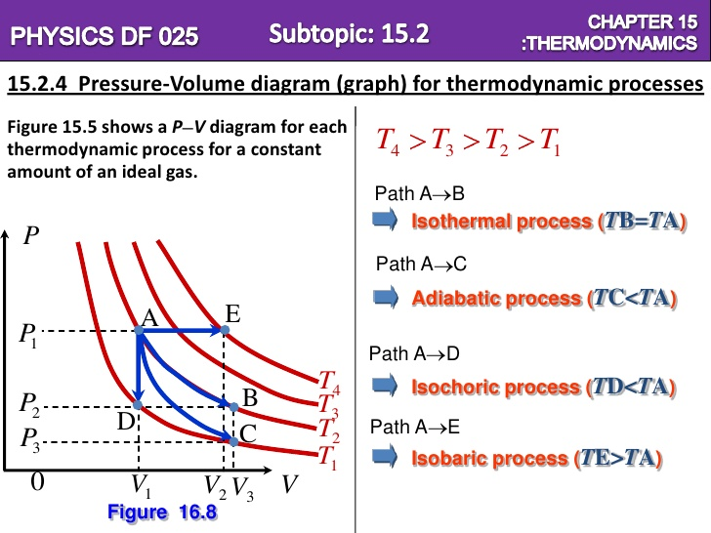
PV curves for Isothermal, Adiabatic, Isochoric and Isobaric Processes
A comparison of the final temperatures with the initial

Slide 38
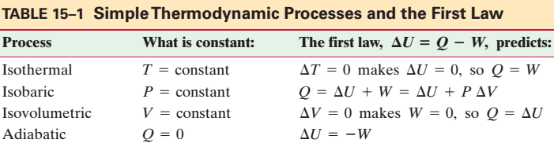
Isobaric Constant pressure W = PΔV
Isochoric Constant volume W = 0
Isothermal Constant temperature Q = W
Adiabatic No heat transfer Q = 0

Slide 39
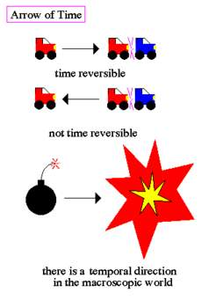
Reversible and Irreversible Process
The reversible process is the ideal process which never occurs, while the irreversible process is the natural process that is commonly found in nature. When we tear a page from our notebooks, we cannot change this and ‘un-tear’. This is an irreversible process. Whereas when water evaporates, it can also be condensed in the form of rains. This is a reversible process.

Slide 40
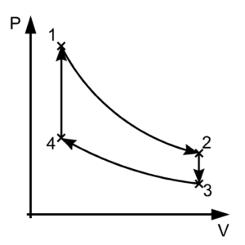
Reversible Process
A thermodynamic process is reversible if the process can return back in such a that both the system and the surroundings return to their original states, with no other change anywhere else in the universe. It means both system and surroundings are returned to their initial states at the end of the reverse process.
Internally reversible process
The process is internally reversible if no irreversibilities occur within the boundaries of the system. In these processes, a system undergoes through a series of equilibrium states, and when the process reverses, the system passes through exactly the same equilibrium states while returning to its initial state.
Externally reversible process
In externally reversible process no irreversibilities occur outside the system boundaries during the process. Heat transfer between a reservoir and a system is an externally reversible process if the surface of contact between the system and reservoir is at the same temperature.
In the figure above, the system has undergone a change from state 1 to state 2. The reversible process can reverse completely and there is no trace left to show that the system had undergone thermodynamic change. During the reversible process, all the changes in state that occur in the system are in thermodynamic equilibrium with each other.

Slide 41
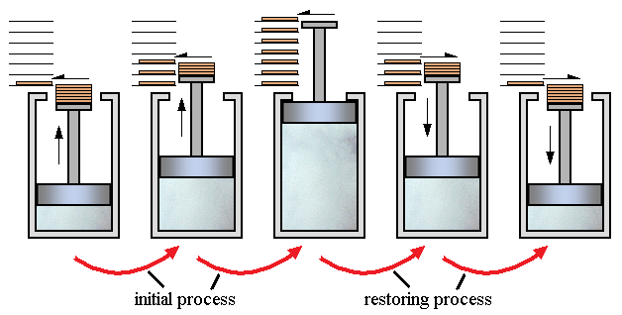
Reversible Process
A process can be reversible only when its satisfying two conditions
Dissipative force must be absent.
The process should occur in infinite small time.
In simple words, the process which can reverse back completely is a reversible process. This means that the final properties of the system can perfectly reverse back to the original properties. The process can be perfectly reversible only if the changes in the process are infinitesimally small. In practical situations it is not possible to trace these extremely small changes in extremely small time, hence the reversible process is also an ideal process. The changes that occur during the reversible process are in equilibrium with each other.

Slide 42
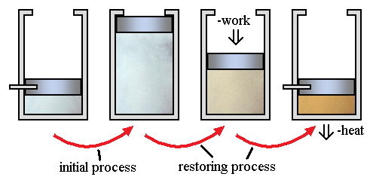
Irreversible Process
irreversible processes are a result of straying away from the curve, therefore decreasing the amount of overall work done. An irreversible process is a thermodynamic process that departs from equilibrium. In terms of pressure and volume, it occurs when the pressure (or the volume) of a system changes dramatically and instantaneously that the volume (or the pressure) do not have the time to reach equilibrium.
A classic example of an irreversible process is allowing a certain volume of gas to release into a vacuum. By releasing pressure on a sample and allowing it to occupy a large space, the system and surroundings are not in equilibrium during the expansion process.

Slide 43
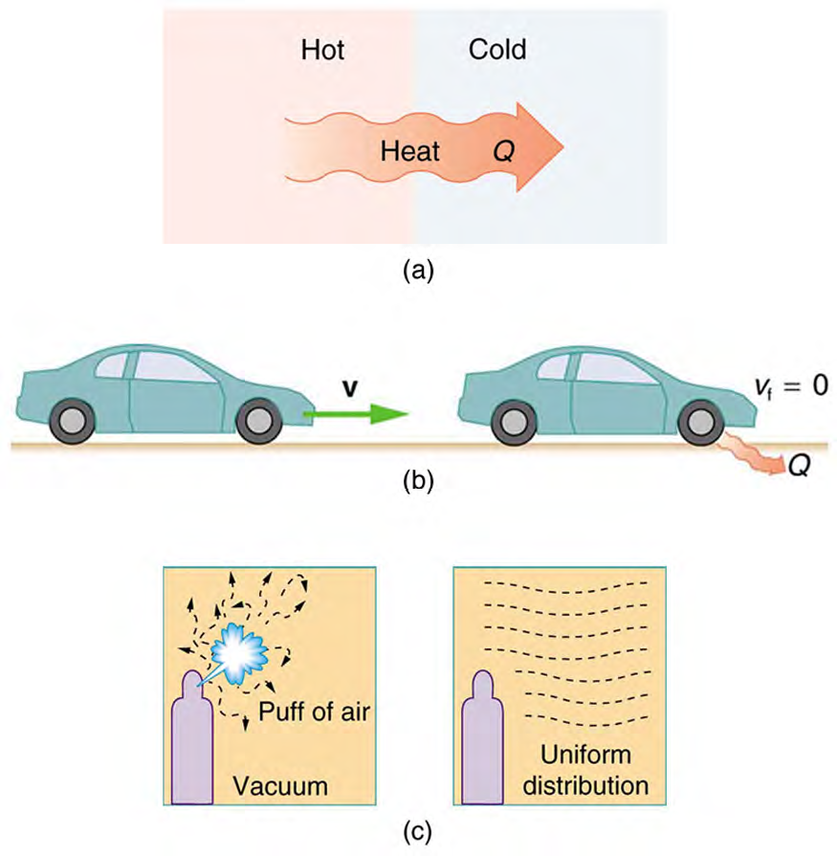
Examples of one-way processes in nature. (a) Heat transfer occurs spontaneously from hot to cold and not from cold to hot. (b) The brakes of this car convert its kinetic energy to heat transfer to the environment. The reverse process is impossible. (c) The burst of gas let into this vacuum chamber quickly expands to uniformly fill every part of the chamber. The random motions of the gas molecules will never return them to the corner.

